Slide 1
23MAT214 Mathematics for Intelligent Systems 4
Graph-Based Classification of Synchronization States
PRESENTED BY
GROUP B3
FACULTY IN-CHARGE
TEAM MEMBERS
Dr. Jithin Velayudhan
Assistant Professor,
Center for Computational Engineering and Networking (CEN),
Amrita Vishwa Vidyapeetham, Coimbatore
Aditya S – CB.AI.U4AID24104
Ashwin Naresh M– CB.AI.U4AID24106
Divya Rithanya S– CB.AI.U4AID24113
Vivethasri C– CB.AI.U4AID24162

Slide 2
INTRODUCTION
Synchronization is a fundamental phenomenon observed in coupled dynamical systems, where interacting oscillators adjust their phases due to coupling.
Depending on system parameters, oscillators may exhibit:
• Weak synchronization • Partial synchronization • Strong synchronization
Understanding and identifying these synchronization regimes is important in physics, biology, engineering, and complex systems analysis.
In this work, we analyze phase-difference signals of coupled oscillators and propose a graph-based framework for automatic synchronization classification.

Slide 3
OBJECTIVES
The main objectives of this project are:
To analyze phase-difference signals from coupled oscillators.
To convert continuous phase signals into symbolic sequences using discretization.
To construct phase-transition graphs representing signal dynamics.
To extract graph-theoretic features that capture structural and dynamical behavior.
To classify synchronization states using machine learning models.
To evaluate model performance and interpret discriminative features.

Slide 4
PROBLEM STATEMENT
Coupled oscillators exhibit different synchronization behaviors depending on system dynamics and coupling strength.
The challenge is to automatically identify synchronization regimes from phase-difference time-series data.
Traditional approaches rely on signal-based features such as Fourier transforms and entropy measures.
In this project, we propose a graph-based representation of phase dynamics and classify synchronization states using structural graph features.

Slide 5
DATASET
The dataset is a matrix of size (156, 50001).
Each row represents the instantaneous phase difference between two coupled oscillators, sampled at discrete time instants.
Mathematically, each signal can be expressed as:
The dataset is labeled into three synchronization states:
State 1: Weak / no synchronization
State 2: Partial synchronization
State 3: Strong synchronization

Slide 6
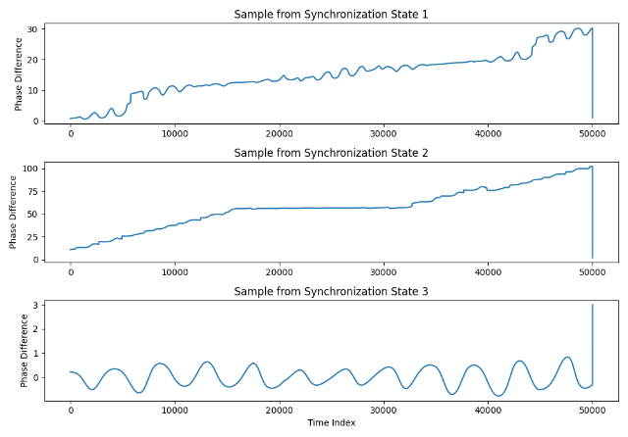
RAW SIGNAL ANALYSIS
Based on the dataset structure, the samples are arranged as:
Rows 0–51: Synchronization State 1
Rows 52–103: Synchronization State 2
Rows 104–155: Synchronization State 3

Slide 7


DISCRETIZATION
Each sample is originally: ϕᵢ(j) : {0,1,…,50000} → ℝ
We transform it into: $s_{i}$:{0,1,…,50000}→{0,1,2,…,15}
First compute global minimum and maximum for the dataset:
The interval [$φ_{min}$, $φ_{max}$] is divided into 16 equal-width bins: $Δ=\frac{φ_{max}−φ_{min}}{16}$
Each bin is defined as: $B_{k}=\left[φ_{min}+kΔ, φ_{min}+\left(k+1\right)Δ\right)$ , $k = 0,1,…,15$
Each phase value is mapped to a symbol: $s_{i}\left(j\right)=k \text{if} φ_{i}\left(j\right)∈B_{k}$
Thus, every time instant is assigned exactly one discrete state

Slide 8
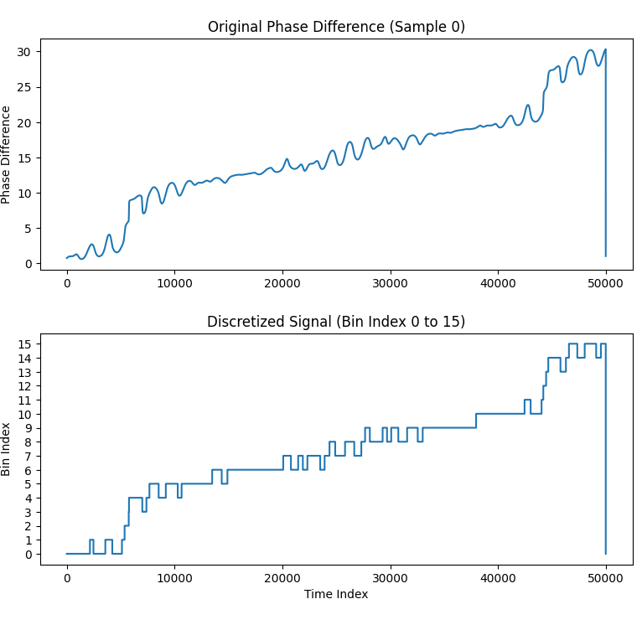
DISCRETIZATION
Result: Each signal becomes a symbolic sequence
Example: [0.71, 0.72, 0.75, 0.90] → [2, 2, 2, 3]
Time order is preserved

Slide 9
TRANSITION GRAPH
From Step 2, each signal is now:
A sequence of symbols: S=[s(1),s(2),…,s(T)],s(t)∈{0,1,…,15}
Each symbol represents which bin the phase value fell into at that time instant.
GRAPH CONSTRUCTION IDEA:
Each bin index (0 to 15) is treated as a node
A directed edge is drawn from node i to j if:
s(t)=i and s(t+1)=j
If the same transition occurs many times, its edge weight is increased.
So the graph captures “from which bin does the signal move to which bin, and how often”
Thus, the graph is: G = (V,E)

Slide 10
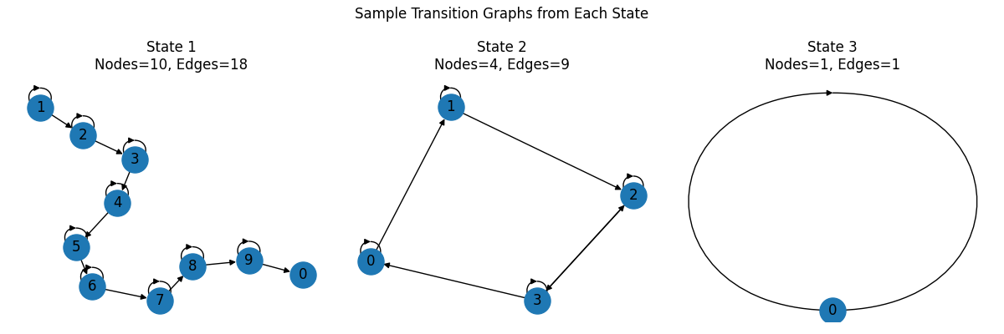
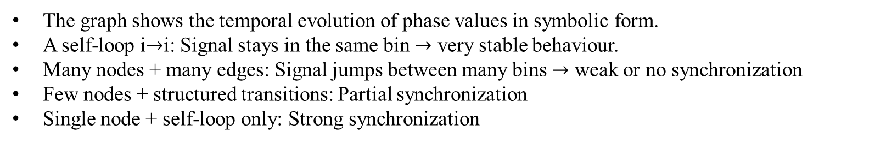
TRANSITION GRAPH
The graph shows the temporal evolution of phase values in symbolic form.
A self-loop i$→$i: Signal stays in the same bin $→$ very stable behaviour.
Many nodes + many edges: Signal jumps between many bins $→$ weak or no synchronization
Few nodes + structured transitions: Partial synchronization
Single node + self-loop only: Strong synchronization

Slide 11


FEATURE EXTRACTION
1. Number of Nodes (Num_Nodes) Total number of distinct symbols that actually appear in the signal:
$$N=∣V∣$$
This shows how many discrete states are visited by a signal.
2. Number of Edges (Num_Edges) Total number of distinct transitions:
$$M=∣E∣$$
Indicates how complex the symbol switching is.
3. Graph Density (Density) Measures how full the graph is compared to a complete directed graph:
$$D=M÷N\left(N−1\right)$$
Higher density means more possible transitions are being used.
4. Mean Degree (Mean_Degree) Average number of connections per node:
$$\overset{ˉ}{k}=\frac{1}{N}\sum_{i=1}^{N}{k_{i}}$$
5. Standard Deviation of Degree (Std_Degree) Measures variation in connectivity:
$$σ_{k}=\sqrt{\frac{1}{N}\sum_{i=1}^{N}{(}k_{i}−\overset{ˉ}{k})^{2}}$$
High value means some nodes are much more connected than others.
Self-Loop Ratio (Self_Loop_Ratio) Fraction of transitions where a symbol repeats
$$R= Number of selfloops ÷ M$$
High value indicates persistence in the same symbol.
7. Number of Strongly Connected Components (Num_SCC) Counts how many strongly connected subgraphs exist:
$$\text{Num}\text{_}\text{SCC}=\text{number} \text{of} \text{SCCs} \text{in} G$$
Many SCCs mean fragmented dynamics.

Slide 12
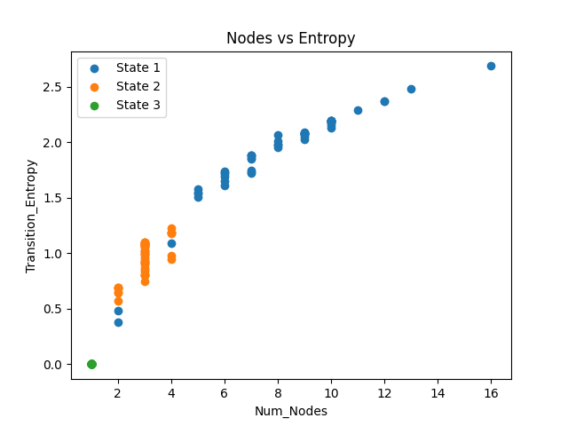
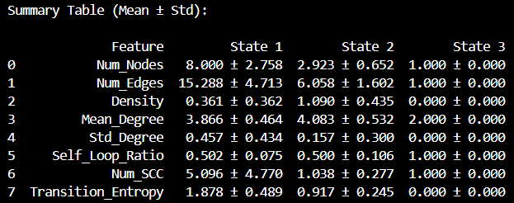
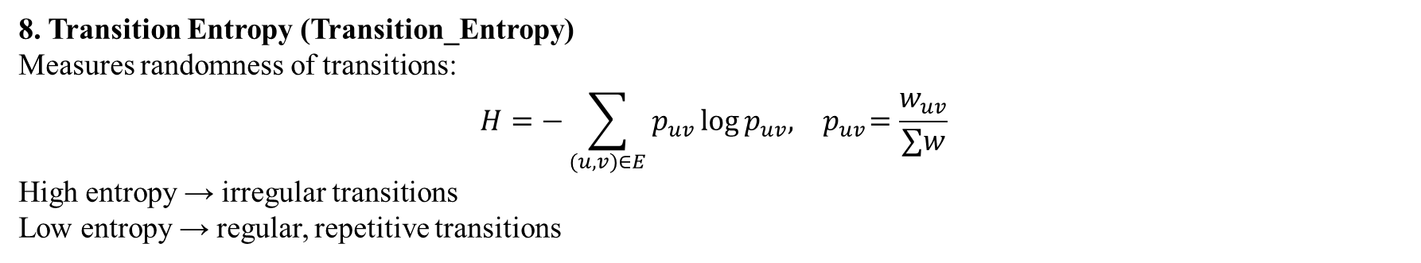
FEATURE EXTRACTION
8. Transition Entropy (Transition_Entropy) Measures randomness of transitions:
$$H=−\sum_{(u,v)∈E}{p_{uv}}log⁡p_{uv},{ p}_{uv}=\frac{w_{uv}}{∑w}$$
High entropy → irregular transitions Low entropy → regular, repetitive transitions

Slide 13
CLASSIFICATION
Input: 156 samples
Each sample = 8 graph features
Split: 75% training, 25% testing
Models used: Random Forest, SVM, Logistic Regression
1. Random Forest Classifier
Type: Ensemble of decision trees
Parameters:
Number of trees = 150
Random state = 1
Advantage:
Handles nonlinear boundaries
Robust to feature scaling
Performs well on mixed feature types
2. Support Vector Machine (SVM)
Kernel: Radial Basis Function (RBF)
Parameters:
C = 1
Gamma = "scale"
Advantage:
Effective for nonlinear class separation
Maximizes margin between classes
3. Logistic Regression
Type: Linear classifier
Parameters:
Maximum iterations = 2000
Advantage:
Simple baseline model
Tests whether features are linearly separable

Slide 14
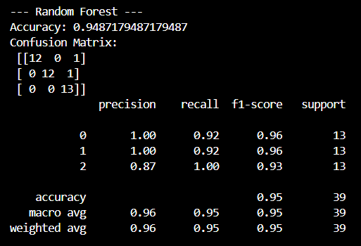
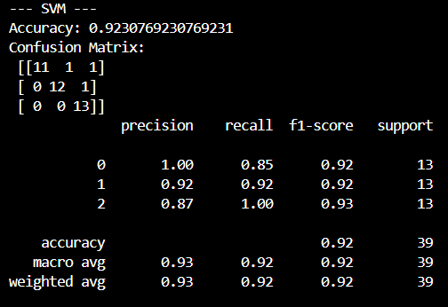
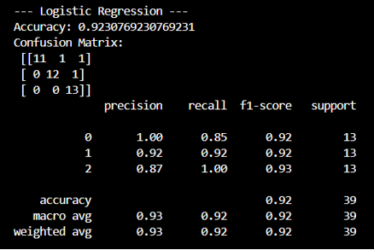
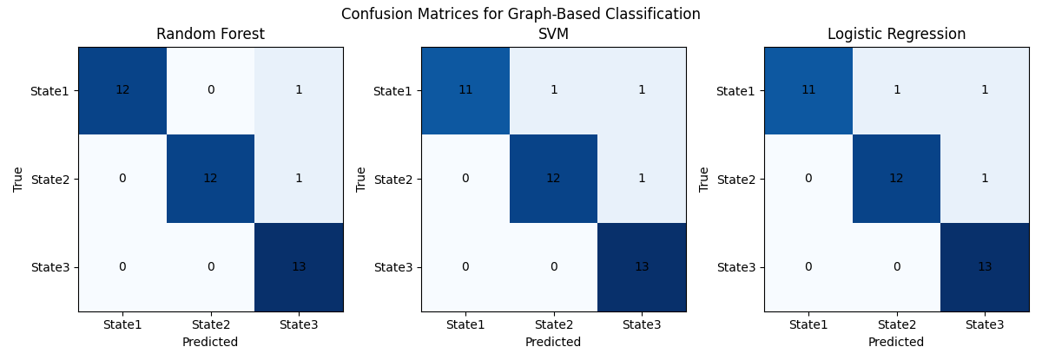
CLASSIFICATION

Slide 15
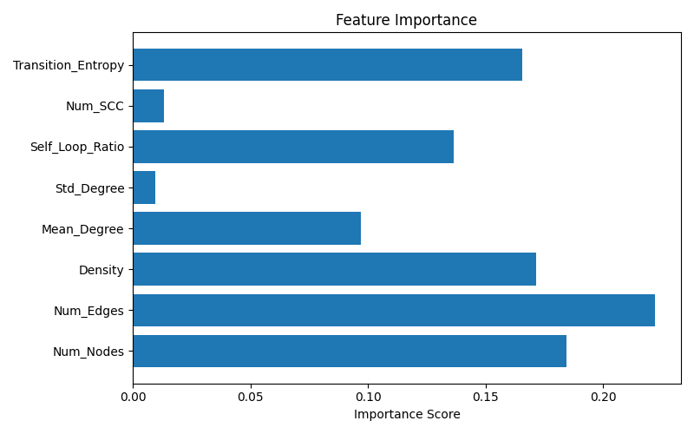
FEATURE IMPORTANCE

Slide 16
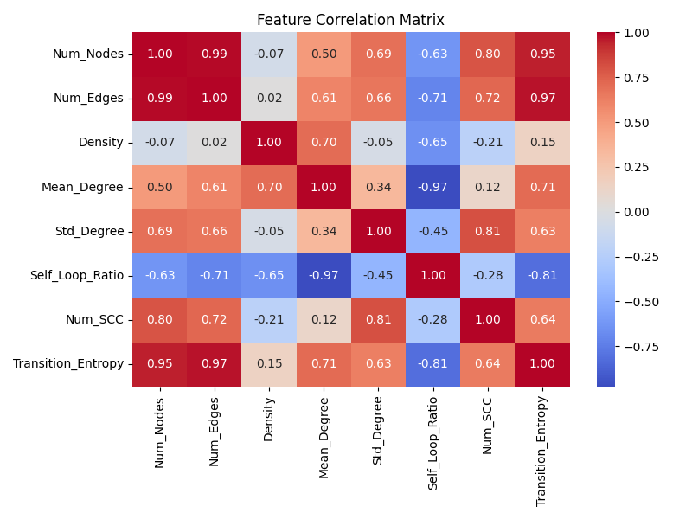
FEATURE CORRELATION

Slide 17
THANK YOU !!

